Slide 1
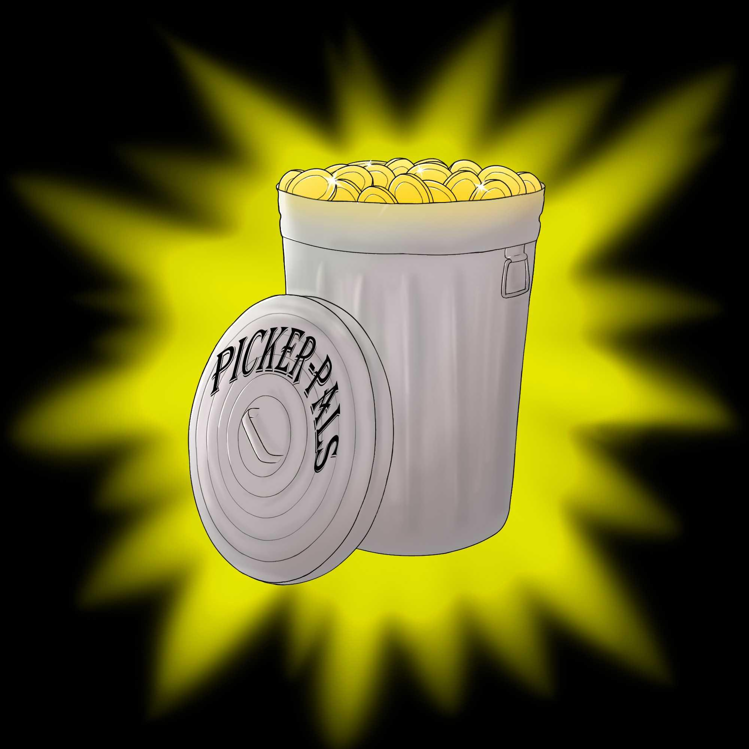
PickerPAL
Joseph Antaki Ryan Beebe Matthew DeGenaro Manoj George
Joseph McIlvaine Gianluca Solari Sean Spencer Joseph Whittier

Slide 2
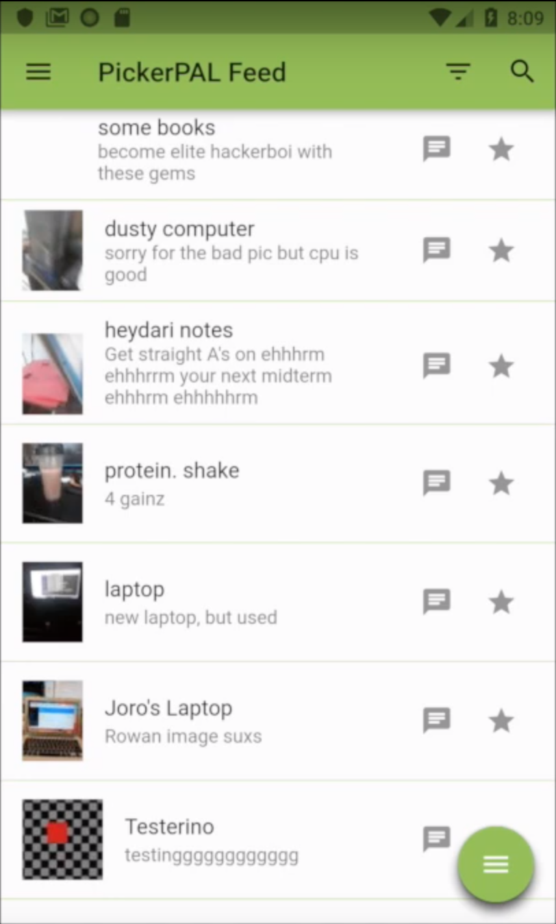
What is PickerPAL?:
A platform unifying trash pickers and those who discard unwanted - yet usable - items.
Allows the Picker and Provider to communicate with one another via the chat interface to come to any agreement (i.e. reserving items, directions, etc.)

Slide 3
Two sides to PickerPAL:
Picker:
Can view items feed & select/view items in more detail
Able to use the filter & search functions to narrow down the viewable items
Able to add tags to their Desired Items & be alerted when an item matching the tag is posted
Able to rate the Provider
Provider:
Needs to sign in with their Google account to post an item
Can view the My Items page & delete the items they have posted
Can act as a Picker as well

Slide 4
General Goals:
The main goals of this project were to:
1. Develop a simple, convenient application that streamlines the process of getting rid of unwanted items or useable waste.
2. Provide a platform for those who participate in trash picking regularly to further enhance their experience.
3. Create a well-written TOS so the creators of PickerPAL are not liable in the event of any wrongdoing during an encounter.
4. Have an active feed of postings.

Slide 5
PickerPAL Features:
List Items: A person can list items that they are looking to get rid of and provide a picture along with other relevant information
Feed: Users are presented with a dynamic feed of listings that they can view.
Search: Users can use a search bar to search for items that they are interested in.
Database: Users, listings, and other information will be stored in a database
Profiles: Users will have profiles that will contain features such as uploaded items, desired items, and ratings.
Chat System: Users can chat with other users about interest in a particular listing.
Report System: Users can report fake listings or rude messages.
Keyword Alert System: Keyword based alerts for new submissions, so users can be updated as items they desire are listed.

Slide 6
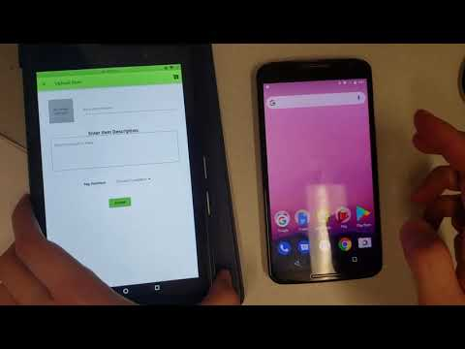
Video Demonstration
https://www.youtube.com/watch?v=sQwZDmgt3nU

Slide 7
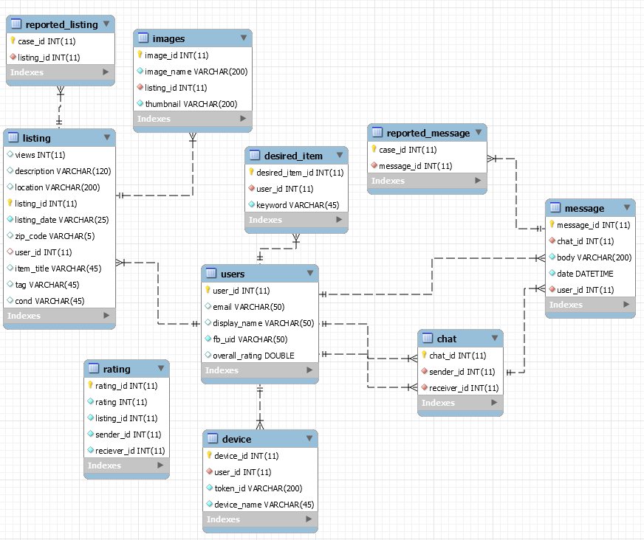
Database Schema

Slide 8


Technology Stack
Front-End:
Flutter
Google Sign-in
Image Picker
Firebase Messaging
Firebase Authentication
Back-End:
Amazon EC2 (Ubuntu)
MySQL
Python
Flask
SQLAlchemy
Marshmallow
PyFCM
Python Image Library

Slide 9
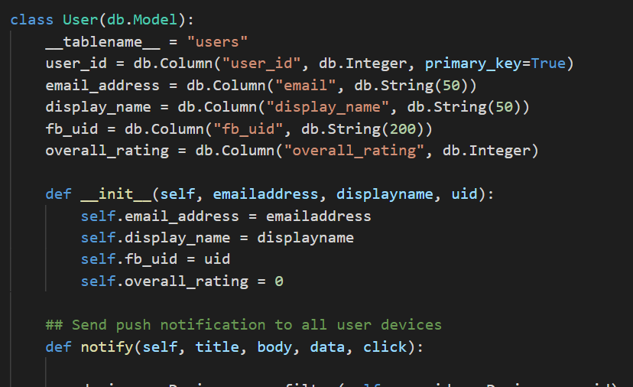
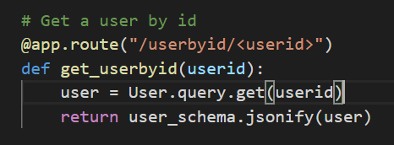
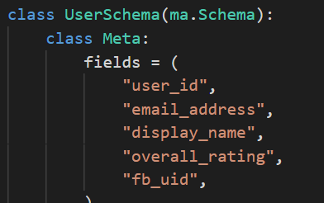

Slide 10
Tribulations
At first, we used the mySQLdb library to concatenate proper SQL queries from within Python and send them off to the database. This required several messy function calls to format queries properly and execute them.
SQLAlchemy instead let us map database tables to traditional objects in Python. We interacted with the DB by instantiating those classes and calling functions on them as one would with any object.
Logging onto your PICKERpal account from different devices posed a problem, as the database originally only stored one device token per user.
The DB was modified so that users could have several tokens/devices under their name

Slide 11
Tribulations, part 2
We needed to decide how we would efficiently notify users of new uploads that matched a user’s desired criteria.
The answer was: every time a new item was uploaded, its title and description were checked for containing keywords that users specified as desired criteria. If there was a match, the users who specified those keywords were sent a push notification using Firebase, through PyFCM. Tapping this notification on the frontend brings up that newly uploaded item.

